Slide 1
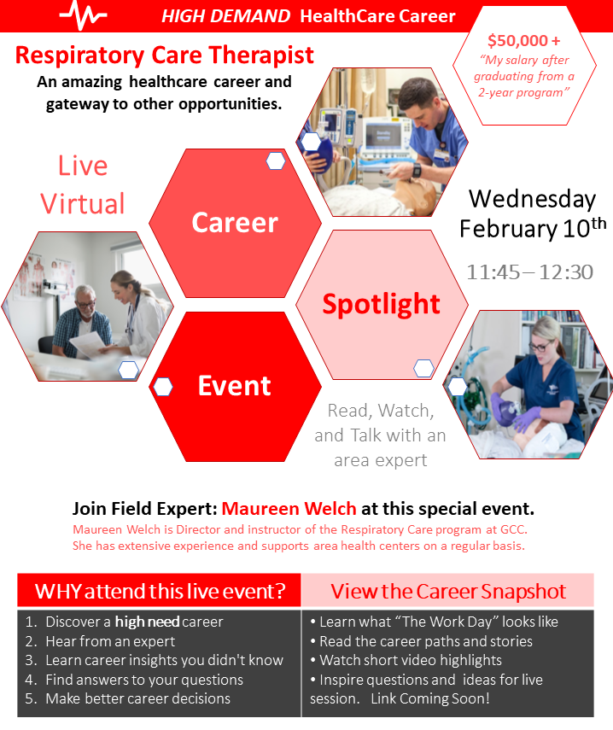

Slide 2
Regional Career Exploration Snapshot
Contact Cory Wright (585) 678-1265 or cory_wright@boces.Monroe.edu If you have questions about this template or other items
service
Healthcare
Respiratory Care Therapist Career
This 2-year degree opens the door to countless opportunities!
https://youtu.be/1llD6HIwTGI
Notes:
Thank you for helping us connect students with regional organizations. This career exploration resource will serve as a catalyst and gateway to deeper exploration. This may include live virtual Q/A with your organization; a virtual tour of your work environment; and participation in career fairs and interviewing opportunities.
This is a flexible template to begin collecting insightful information and visuals to help education K12 students about local career opportunities.
Please share your companies story answering the questions with words and pictures.
Just click in the slide and add your details
Feel free to add or subtract questions as needed.
We will edit and shape once we have you information
See this Company Career Exploration template as a starting point we will collaboratively develop and update as needed
Contact Cory Wright (585) 678-1265 or cory_wright@boces.Monroe.edu If you have questions about this template or other items
This format will allow us to share your story in a variety of ways to best engage and inspire students
As always, we are open and flexible to new ideas and approaches
The MONROE ONE BOCES School to Career Service is focused on efficiently connecting the K12 Educational Community with regional organizations to strengthen education and our future workforce. Please reach out so see how we might support you.

Slide 3
Respiratory Therapist
Common Duties
Diagnosing
Diagnosing lung and breathing disorders and recommending treatment methods
Interviewing
Interviewing patients and doing chest physical exams to determine what kind of therapy is best for their condition
Analyzing
Analyzing breath, tissue, and blood specimens to determine levels of oxygen and other gases
Educating
Educating patients and families about lung disease so they can maximize their recovery

Slide 4
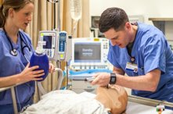
Respiratory Care Therapist
A day in the life.
What does a work day look like for this role?
Getting report from your fellow RT, rounding with the healthcare team on your patients. Taking care of your patients, managing their ventilators, giving them breathing treatments, coaching them with breathing exercises.
Primary work task/activities/skills?
We work every day to help our patients get better. We teach them the techniques to stay well . It is so satisfying to see our patients go home !
Dress code or required equipment for workers?
Most of the time you get to wear scrubs to work. Along with your ID badge and most comfortable sneakers or clogs.
Typical hours, Work Shift options and overtime?
Shifts can be 7a-7p, 7a-3p, 3p-11p, 7p-7a. Any day of the week. There is A LOT of overtime available right now due to COVID 19.
What training do you offer for this job/role?
2yr and 4yr degree programs with certification test. You will be ready to work at any hospital in the area . Recently, 100% job placement

Slide 5
Respiratory Therapy is provided in nearly all health care venues
Acute care hospitals (where about 75% of respiratory therapists are employed)
Diagnostic laboratories
Sleep disorder centers
Rehabilitation, long-term acute care and skilled nursing facilities
Patients’ homes
Patient transport systems
Physicians’ offices
https://youtu.be/xUQ8WmyLkUw
Convalescent and retirement centers
Educational institutions
Wellness centers
https://explorehealthcareers.org/

Slide 6
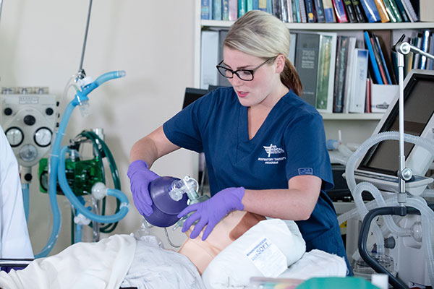
Career entry-point Opportunities
Healthcare
In Demand Patient Centered Careers in Healthcare
Entry Level | Middle Skills Certificate; Apprentice Training | 2 Yr College Training | 4 Yr + College Training
Environmental Services Tech Materials Handling Tech | Home Care Assistant/Aide Pharmacy Technician Nurses Aide / Assistant | Respiratory Care Therapist (2 yr degree + pass boards) | BS Respiratory Care BS Nursing Physician's Assistant Perfusionist Many other health careers
One of the many great things about being and RT is that the profession is dedicated to patients of all ages and circumstances.
Maybe you’re interested in working with newborns or children. Or maybe
you’re interested in the fast-pace world
of transport. Wherever you want to take your career, respiratory care
is there.

Slide 7
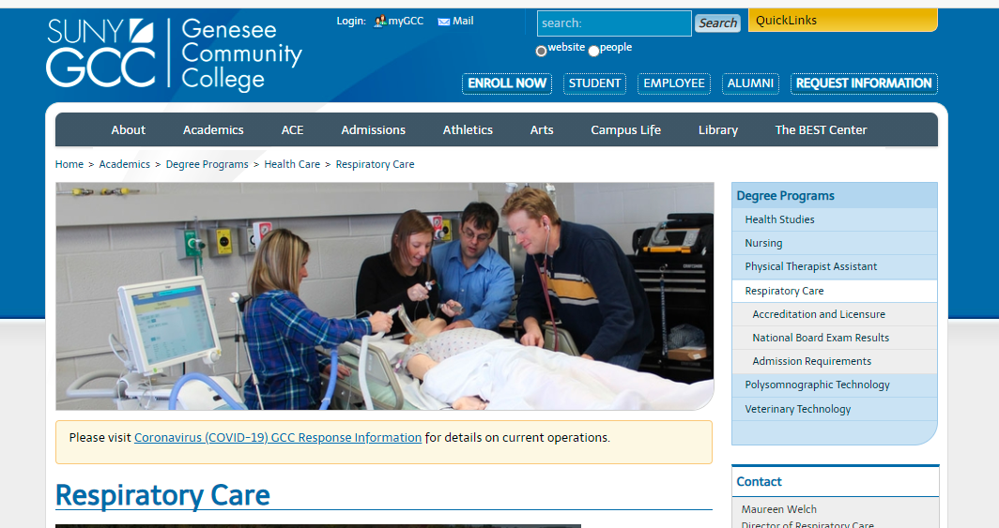
Genesee Community College
Contact Cory Wright (585) 678-1265 or cory_wright@boces.Monroe.edu If you have questions about this template or other items
PROGRAM SPOTLIGHT
Respiratory Care Program
100% job placement
Starting Salary in Upstate NY
$49,500
Between 2012-2022
HIGHLIGHTS
Do you like a big Research hospital or do you prefer a smaller community hospital?
During the program you will attend clinical at several hospitals and long-term care facilities across Western NY.
You will learn where you feel most comfortable.
Prerequisites:
A 75 or higher on the regents exam in chemistry and living environment.
Having some patient care experience is helpful, but not necessary
Helping people and making a difference
LINK TO PROGRAM https://www.genesee.edu/home/academics/programs/health/respcare/

Slide 8
Respiratory Care Therapist
Contact Cory Wright (585) 678-1265 or cory_wright@boces.Monroe.edu If you have questions about this template or other items
Resources and Programs
RESOURCES
AARC www.aarc.org
American Association of Respiratory Care
NBRC www.nbrc.org
National Board of Respiratory Care
NYSSRC www.nyssrc.org
New York State Society of Respiratory Care
Explore Health Careers https://explorehealthcareers.org/
Area PROGAMS
GCC 2-year AAS https://www.genesee.edu/home/academics/programs/health/respcar
ECC 2-year AAS Erie Community College :: Respiratory Care (ecc.edu)
SUNY UPSTATE MEDICAL is a 4-year BS program Respiratory Therapy and Care | Upstate Community Hospital | SUNY Upstate Medical University

